Slide 1
Preliminary Results of the Global Forest Biomass Survey
Sean P. Healey, Paul L. Patterson,
Chris Woodall
US Forest Service
Erik Lindquist
UN Food and Agriculture Organization
Michael Lefsky
Colorado State University
Michael W. Hernandez, David Edwards
Weber State University

Slide 2
Background:
Biomass per hectare is an important coefficient for many international carbon accounting frameworks
Many countries do not have designed national forest inventories to produce this coefficient
Important methodological differences exist among countries that do have national forest inventories
Notes:
¾ of the world’s forestland was reported in the last UN Forest Resources Assessment using international defaults or unknown methods

Slide 3
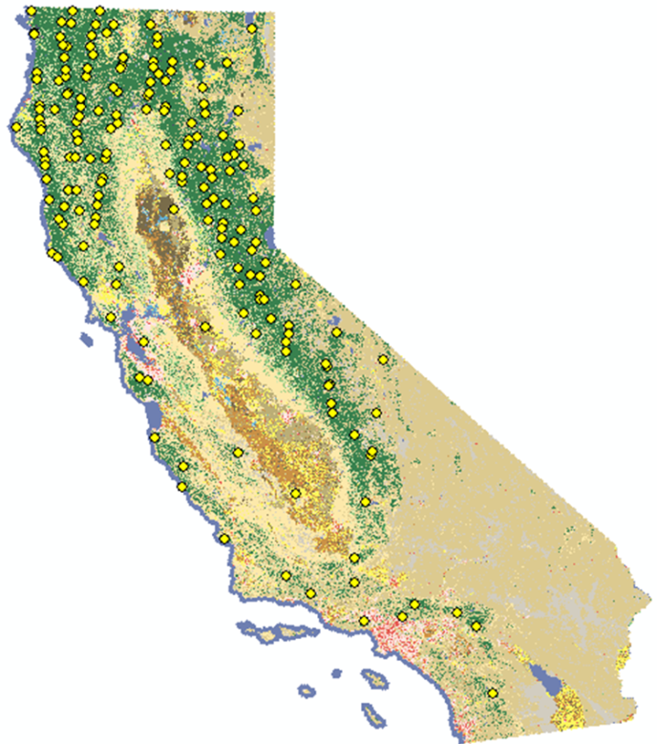
Using a statistically defined subset of GLAS with available ground data, we can use model-based inference to estimate biomass/ha
Pilot Study: California
(Healey et al., 2012)
Lidar-based sampling
National Forest Inventory
Notes:
Good match with FIA estimate in CA. Our standard error was obviously greater, but this method can be extended anywhere and cost a fraction of the $10million FIA paid for CA’s estimate

Slide 4
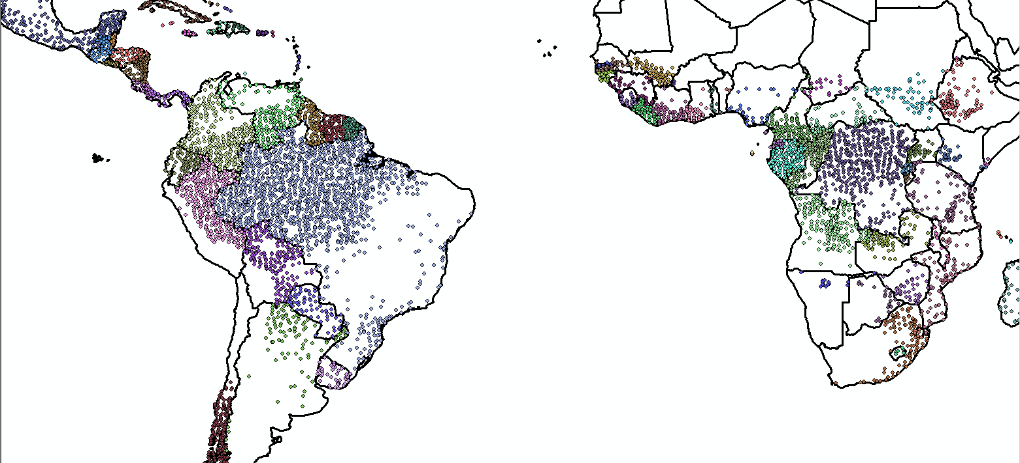
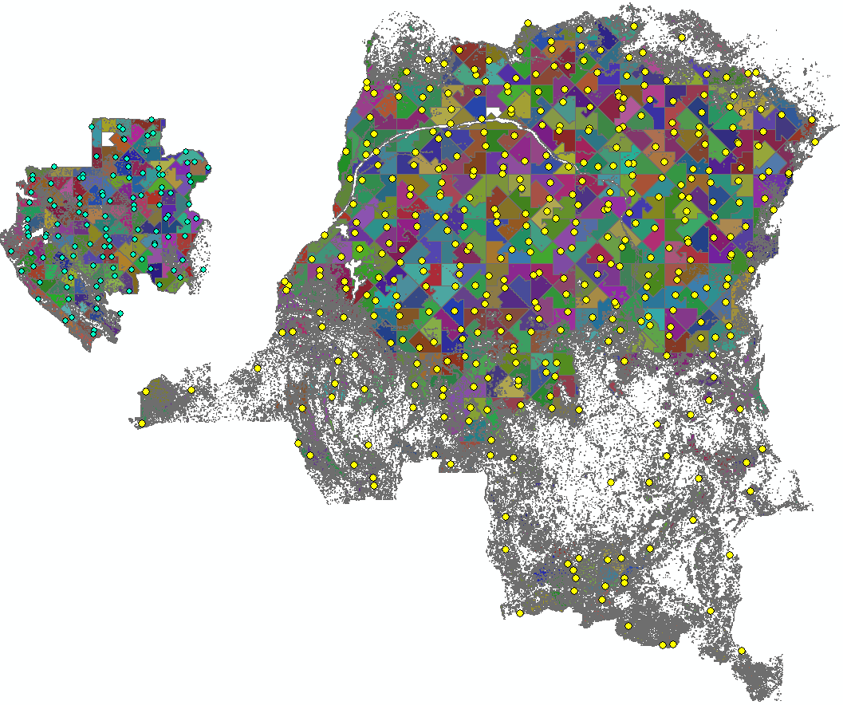
Gabon GLAS sample (n=117)
Optimized GLAS samples have been established for all countries
Democratic Republic of Congo GLAS sample (n=410)

Slide 5
Average canopy height* has been estimated for each country
*not accounting, yet, for GLAS measurement error

Slide 6
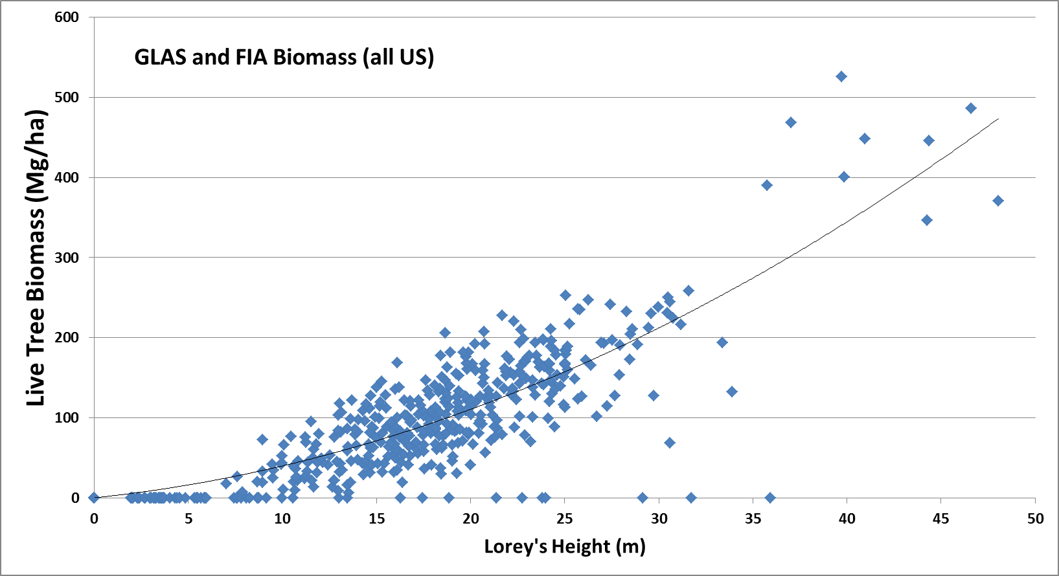
We are in the process of using the samples to estimate biomass
Notes:
Relationship is good across the US

Slide 7
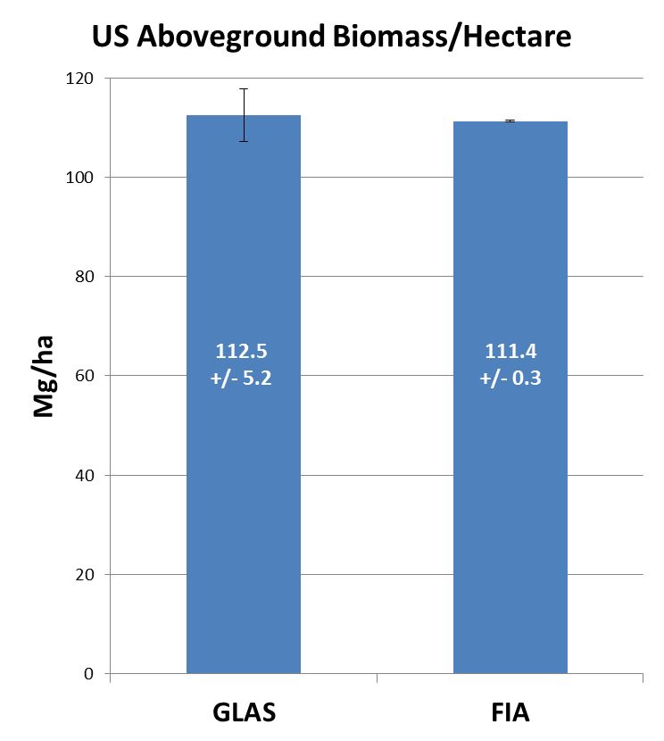
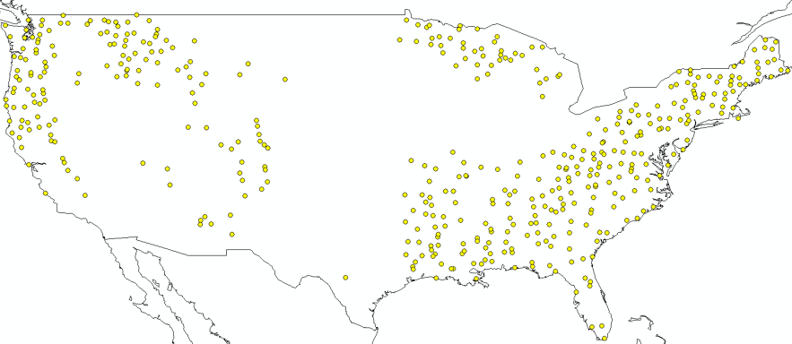
Estimate for the United States (without Interior Alaska) matches FIA’s estimate
191 million ha: IGBP forest cover classes in global MOD12Q1 product
201 million ha: stocked timberland

Slide 8
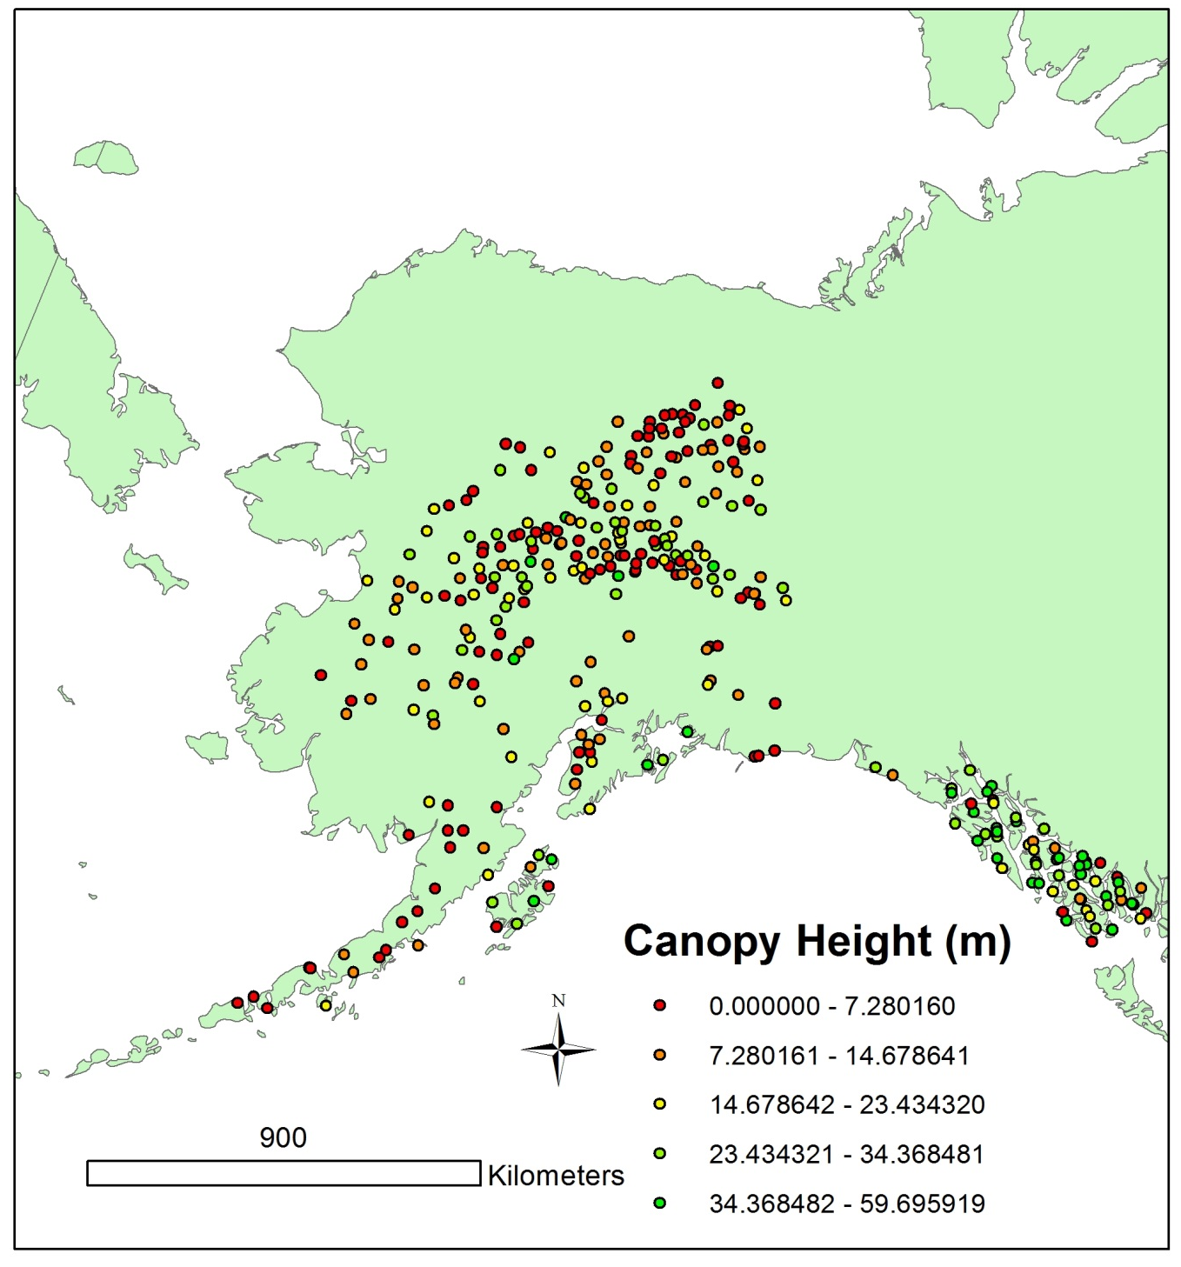
We are using the sample to estimate biomass for Alaska
Notes:
Filling a need

Slide 9
Currently:
Finalizing global model-building ground sample points (currently composed of NFI and FAO data from selected countries)
Estimates to be distributed through the UN Food and Agriculture Organization to individual country correspondents
Sampling concepts from this project are being implemented on the GEDI biomass mission

